Slide 1
CIS117 Week 8
shellscripting

Slide 2
What is a script?
Small programs
A text file with 1 command per line
Comments use a #
Always start with shbang to specify shell type
DEMO samples in module

Slide 3
But, why should I care?
Repetitive tasks
Scheduling repeated activities (backups)
Complicated things you don't use often
If you need to figure it out once, why not make a script so you don't have to do it again?

Slide 4
Types of text
Plain (no quotes)
echo hello
Semi-opaque (double quotes, expands variables)
echo "hello $name"
Opaque (single quote, shows exactly what's in quotes)
echo 'hello $name'
DEMO results of each type

Slide 5
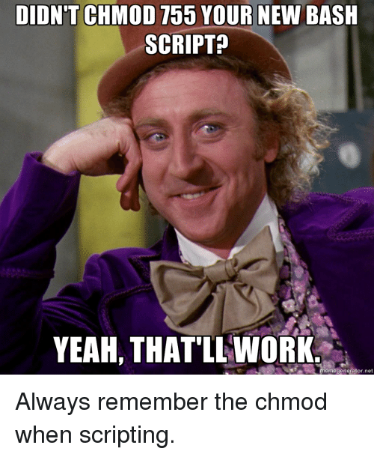
Important things to know
Backticks
Shbang line
To run, file must be executable (it's not by default)
Most common beginner mistake
To run you need to use the path (unless in PATH)
Second most common beginner mistake
https://onsizzle.com/t/bash-scripting

Slide 6
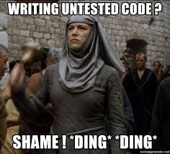
Sequence for a successful script
Test commands at command prompt
Create and edit the file in an editor (VIM)
Start script with shbang line (#!/bin/bash)
Add comment with function, name and date
Save
Change permissions
Test!!
Rinse and repeat
https://memegenerator.net/instance/63088250/shame12345-writing-untested-code-shame-ding-ding

Slide 7
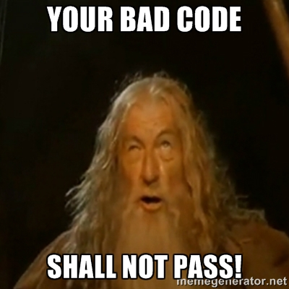
Reminder to test your code
Must submit evidence of testing on blackboard
DEMO how to submit labs
https://jameskbride.com/2015/09/12/broken-windows-and-how-to-fix-them.html

